Slide 1
Email Spam Detection
Done By
SHAIK IRFAN [RA2011026010080]
ARAVIND KRISHNAN R [RA2011026010077]
MURALI KRISHNA [RA2011026010086]
Start
Table of contents
Back
Next

Slide 2
Table of contents
01
02
03
Abstract
Problem Statement
Limitations
04
05
06
07
Objectives
Sys. Arch and Design
Naïve Bayes
Classifiers
Conclusion
Start
Table of contents
Back
Next

Slide 3
01
Abstract
Start
Table of contents
Back
Next

Slide 4
Email spam classification is the process of identifying and categorizing unsolicited and unwanted emails, known as spam, from legitimate and wanted emails, known as ham. The increasing volume of spam in email inboxes has prompted the development of various spam filtering techniques, including rule-based systems, content-based filtering, and machine learning algorithms. Machine learning algorithms have shown great potential in email spam classification due to their ability to automatically learn and improve from data. These algorithms use statistical models to extract relevant features from the email content and header, such as sender information, subject, and message body. Based on these features, the algorithms can predict the likelihood of an email being spam or ham. Overall, email spam classification plays a crucial role in ensuring that email users receive only relevant and wanted messages in their inbox, while keeping unsolicited and potentially harmful emails out

Slide 5
Problem Statement
02
Start
Table of contents
Back
Next

Slide 6
Email has become an essential communication tool for both personal and business purposes. However, the increasing amount of spam emails in our inboxes has become a significant concern, with some estimates suggesting that up to 45% of emails sent worldwide are spam. Email spam refers to unsolicited emails that are sent in bulk to a large number of recipients. These emails often contain malicious links or attachments, phishing scams, or unwanted advertisements, causing inconvenience and potentially even harm to the recipients. To address this issue, email spam detection has become increasingly important. Email spam detection involves identifying and categorizing incoming emails as either spam or legitimate, also known as ham. This is accomplished by utilizing a variety of techniques, including rule-based systems, content-based filtering, and machine learning algorithms.

Slide 7
LIMITATIONS WITH CITATIONS
03
Start
Table of contents
Back
Next

Slide 8
Lack of standard datasets
Imbalanced datasets
Evolving spam techniques
Overfitting
Lack of real-time detection

Slide 9
04
Objectives
Start
Table of contents
Back
Next

Slide 10
Identify and filter out unwanted or unsolicited emails
Reduce the amount of time and effort
Improve productivity
Reduce the risk of cybersecurity threats
Enhance the overall user experience

Slide 11
SYSTEM ARCHITECTURE AND DESIGN
05
Start
Table of contents
Back
Next

Slide 12
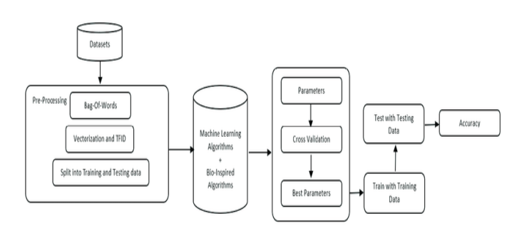
SYSTEM ARCHITECTURE
Start
Table of contents
Back
Next

Slide 13
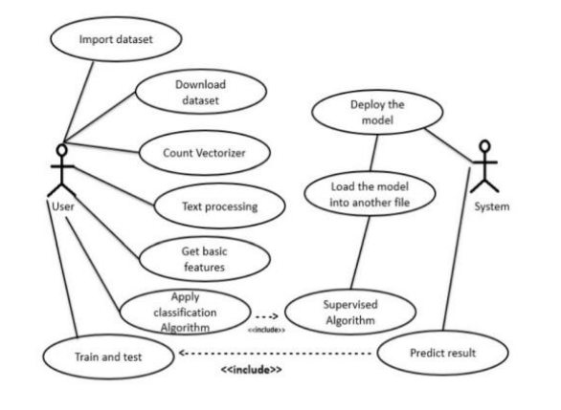
SYSTEM DESIGN
Start
Table of contents
Back
Next

Slide 14
06
Naïve Bayes Classifiers
Start
Table of contents
Back
Next

Slide 15
Naïve Bayes Classifiers is a popular mathematical method for filtering email. See usually use the wallet features to identify spam e-mail approach frequently used to separate text.
Spam filtering of Naïve Bayes is a basic way to deal with such spam it can adapt to the email needs of individual users and provide low-level lies good spam detection rates that are generally accepted by users.
One of the main benefits of screening Bayesian spam is that it can be trained per user.
It can be especially helpful in avoiding false reasoning, where this is legal email is incorrectly labelled as spam.
Using lemmatization recognizes the similarity of words like masculine, bed and beds etc.
Accuracy is improved by using this Classifier Naïve Bayes. We get the accuracy of 98% use this process

Slide 16
CONCLUSION AND FUTURE ENHANCEMENTS
07
Start
Table of contents
Back
Next

Slide 17
Conclusion
This project, spam detection is proficient of detecting mails giving to the content of the email. Detecting the spam emails can be done on the basis of the trusted and verified domain names. The spam email classification is incredibly significant in categorizing e-mails and distinct e-mails that are spam or non-spam.
Naive Bayes could a baseline technique for managing with spam to the e-mail needs of individual users and provides low false positive spam detection rates that are generally acceptable to users. The accuracy of the spam detection can increase by using Naïve Bayes Classifier. In future the other optimization algorithm can be used with Naïve Bayes algorithm.
By evaluating the results, we are able to say that the integrated concept ends up in increased accuracy and precision than the individual Naïve Bayes approach.
Start
Table of contents
Back
Next

Slide 18
FUTURE ENHANCEMENTS
Hybrid models
Feature engineering
Human-in-the-loop systems

Slide 19
Thank you
Start
Table of contents
Back
Next

